Slide 1
group systems & Qualify a journey through change Dan Eve old mutual

Slide 2
About Me
Business Information Systems @ Solent University
Business Systems Analyst @ Chemring Countermeasures
Test Analyst @ Skandia UK
Business Analyst @ Old Mutual - Group Head Office

Slide 3
my team – group systems
Shared services to the group
Projects and business as usual
Providing end to end change
Recently unified teams
“Group Systems, providing IT solutions that enable GHO and the Global Business to reach their goals”

Slide 4
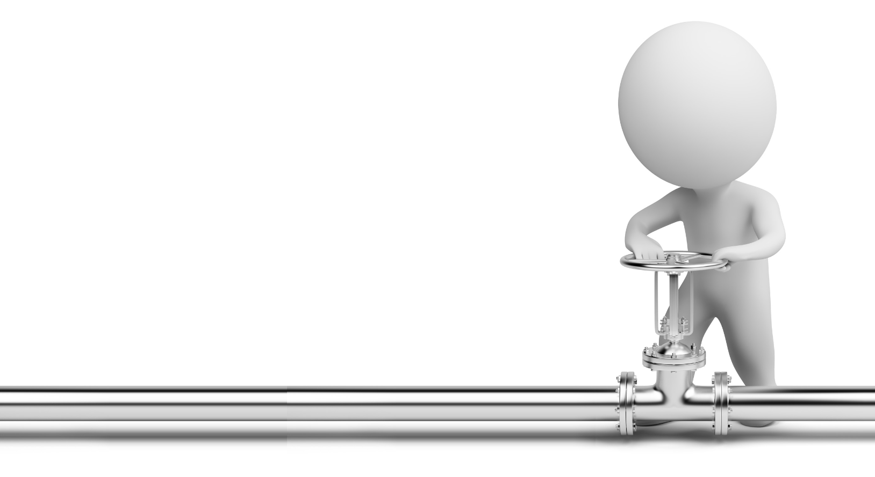
controlled change
Consolidate multiple tools used within the SDLC
Escape spread sheet shackles
Improve audit trails – Data Control and Governance
Controlled SDLC workflow ‘plumbing’

Slide 5
Solutions
TestDrive for automation testing
TestDrive Assist for manual testing
Original Software Animation for user documentation
Qualify Application Quality Management as a complete SDLC management package

Slide 6
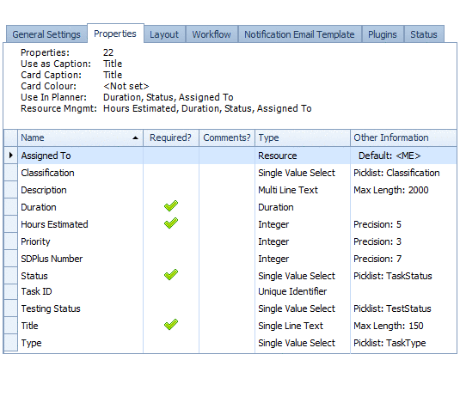
Qualify
Fully Configurable - Entities… Relationships… Workflow
MI Dashboards
Web & Client Access
External Data Sources
Electronic Attestation
Controlled Security

Slide 7
challenges
Agreement on ‘Application Model’
Parallel Pilot - Business As Usual
Cultural change

Slide 8
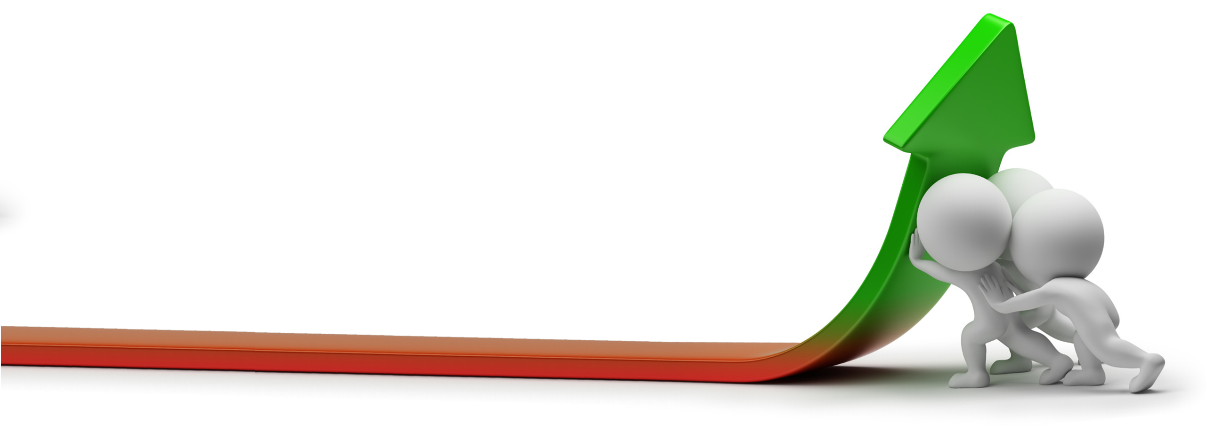
benefits
Centralised Management for Project, Change, Testing and Defects
Ability to evolve workflow rapidly with the business’ needs
Timely and Accurate Management Information
Effortless audit trails

Slide 9
future
Implement Resource Management module
Extend workflow scope
Continue to overcome cultural challenges

Slide 10
Summary
Economically compatible solution delivered
Great training and support from Original Software
Increased efficiencies and improved reporting
Group Systems management is happy!

Slide 11
Want to know more?

